Slide 1
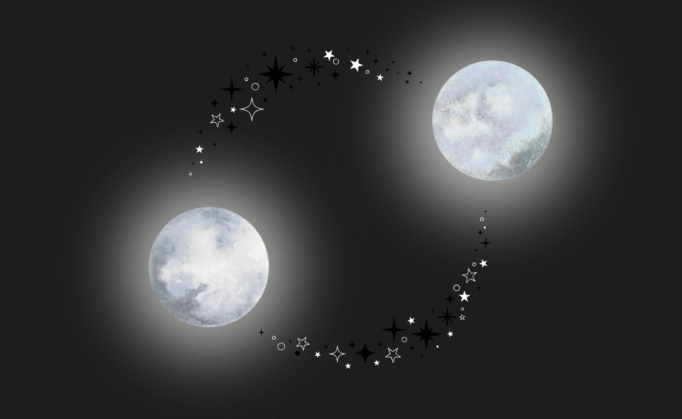
Characterizing Double White Dwarf Star Systems
By G. Leigh Harwell

Slide 2
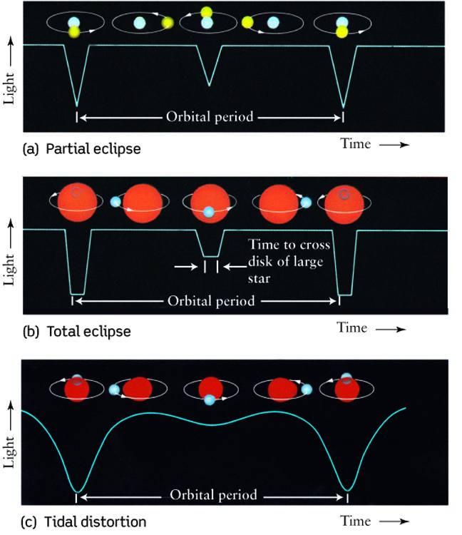
Double White Dwarf System
A DWD system is a binary pair typically consisting of a visible primary and an invisible secondary white dwarf.
Some of the most abundant compact binaries
Good for studying binary evolution
Systems with short orbital periods are predicted to be strong gravitational wave (GW) source
Light curves of various different types of binary systems
(not specifically DWD systems)
Kupfer, Thomas, et al. "LISA Galactic Binaries with Astrometry from Gaia DR3." arXiv preprint, arXiv:2302.12719, 2023
Notes:
Photometric different set of light curves look a thow the flux of it over time, explain the importance of the double white dwarf system and the figures of various light curves with different binary systems (spend a little bit more time on this, maybe a minute)

Slide 3
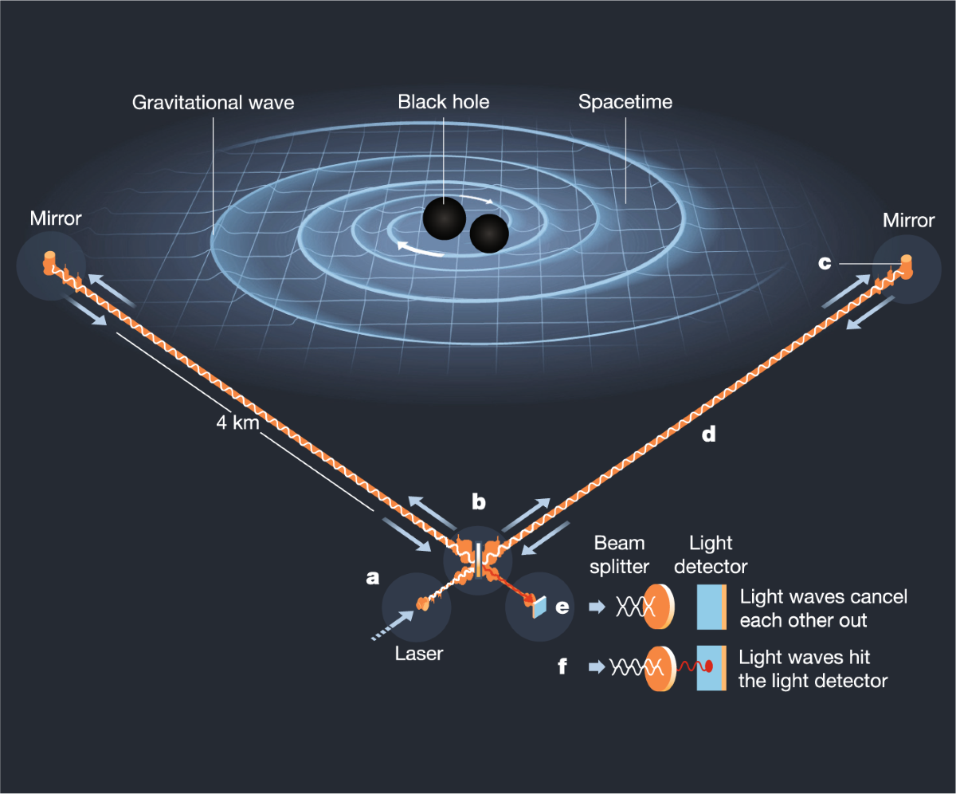
Verification Sources for LISA
Double white dwarfs found via electromagnetic (EM) telescopes serve as essential verification binaries for space-based GW detectors like LISA
sky position, orbital periods and physical properties are already constrained by the optical, their predicted GW signals
Simple diagram of the LIGO detector
from Caltech
Danzmann, Karsten, et al. LISA: Laser Interferometer Space Antenna. arXiv preprint, arXiv:1702.00786, 2017
Notes:
Explain what LISA is, what GW are, and possible how EM effect it or what it is (spend more time on this one than the other 2 before it)

Slide 4
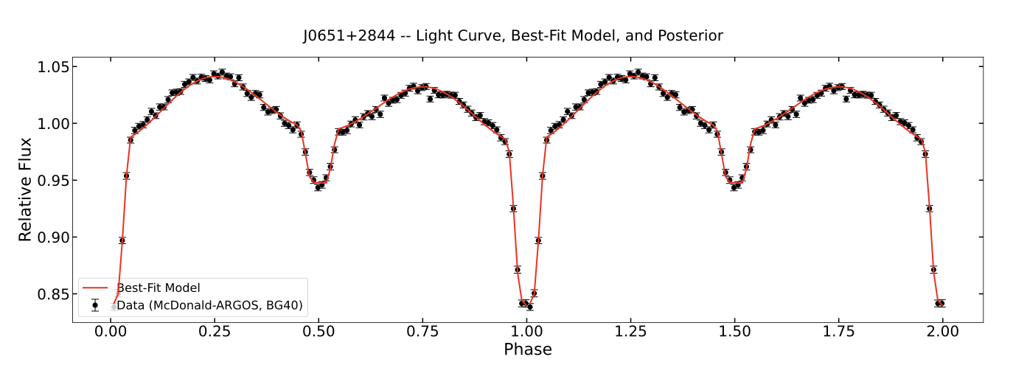
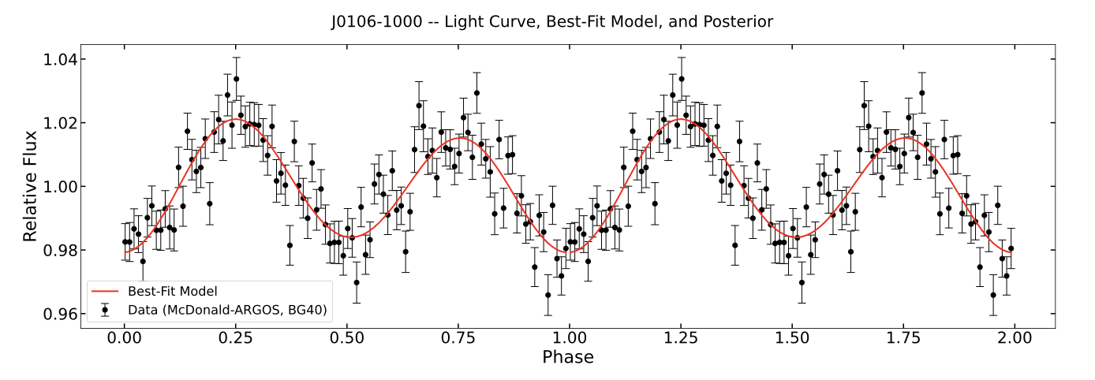
Characterizing DWD Systems
Optical observations shows us modulation of the systems, such as eclipses, ellipsoidal various, doppler beaming and reflections.
Eclipsing systems: Geometry directly constraints masses, radii, and inclination to percent-level precision
Ellipsoid systems: Tidal modulations provide partial constraints when paired with spectroscopic priors
Figure 1: system J0651+2844 light curve of Eclipsing system
Figure 2: system J0106+1000 light curve of Ellipsoid system
Barrientos Laurence, Manuel H. "Progress Report: Electromagnetic and Gravitational Wave Characterization of LISA Binaries in the Extremely-Low Mass Survey." University of Oklahoma, 2025. Research Progress Report
Notes:
Explain what observation of the light curve tells us about the different types of binary light curves and how some can have multiple modulations in one system and say what J0651(doppler, eclipsing, elepsodial) and J0106 are exactly. When we model optical light curves, systems fall into different categories. Eclipsing binaries like J0651 are the gold standard—their eclipse geometry directly yields percent-level precision on masses and inclination. Ellipsoidal systems like J0106 show tidal distortions, giving moderate constraints when paired with spectroscopy. On the top graph for J0651, you can see sharp, deep drops at phase 0 and 1. Those are primary eclipses where one white dwarf passes directly in front of the other. That precise eclipse timing gives us percent-level precision on inclination and masses. On the bottom graph for J0106, there are no eclipses at all—just a smooth, double-humped wave caused by the star being tidally stretched into an oval. Because we lack eclipses, parameter estimates carry 10 to 25 percent error and lean much more heavily on spectroscopic data.

Slide 5
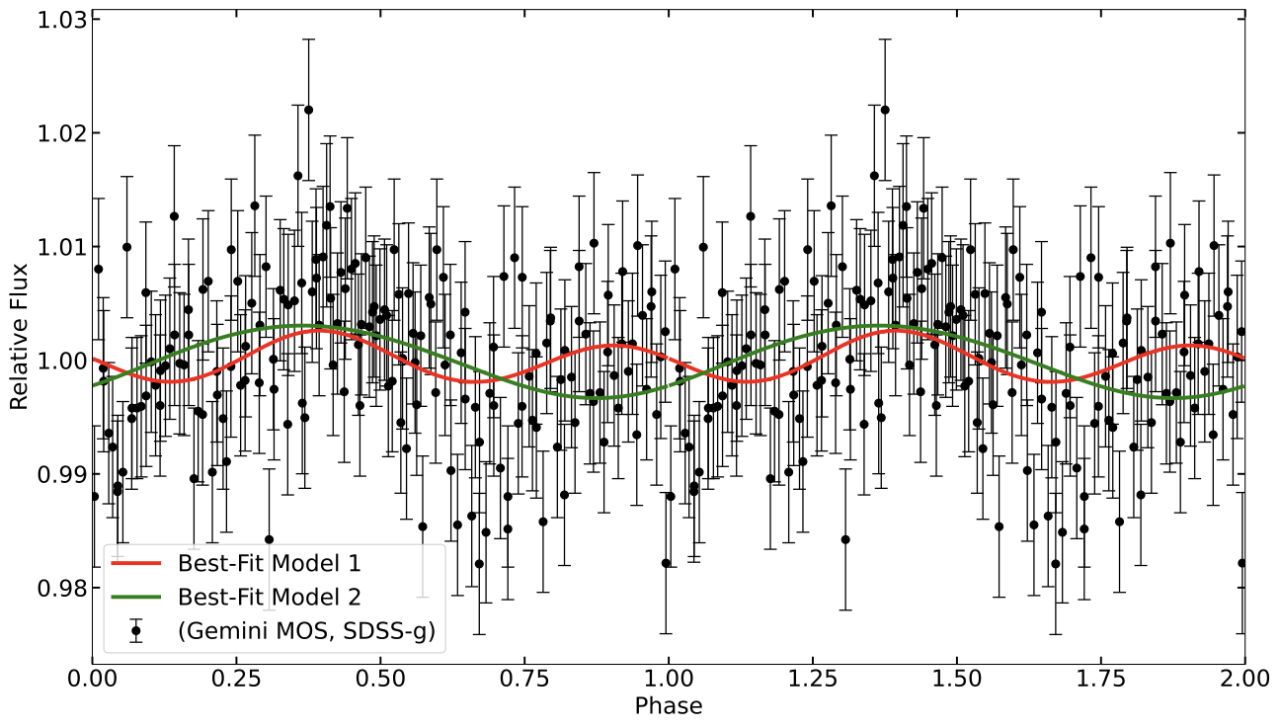
Characterizing DWD Systems
Featureless systems: Flat optical light curves leave inclination unconstrained and parameters strongly degenerate
~54% of DWD light curves in optical surveys are featureless
Figure: system J2322+0509, light curve of Featureless system
red and green line shows the two different lines of best fit of the system
No clear modulations → unknown inclinations → parameter degeneracy → large mass/GW uncertainty
Barrientos Laurence, Manuel H. "Progress Report: Electromagnetic and Gravitational Wave Characterization of LISA Binaries in the Extremely-Low Mass Survey." University of Oklahoma, 2025. Research Progress Report
Notes:
Talk about the issue with the featureless systems and how the modulations affect the systems modeling. However, featureless systems like J2322 present a major challenge. Their light curves are essentially flat, meaning we have no geometric handle on orbital inclination. Without inclination constraints, parameters like secondary mass and overall system geometry suffer from severe mathematical degeneracies.

Slide 6
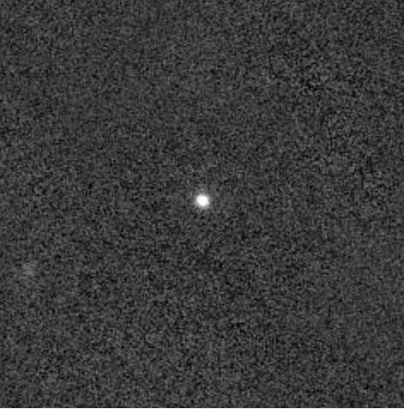
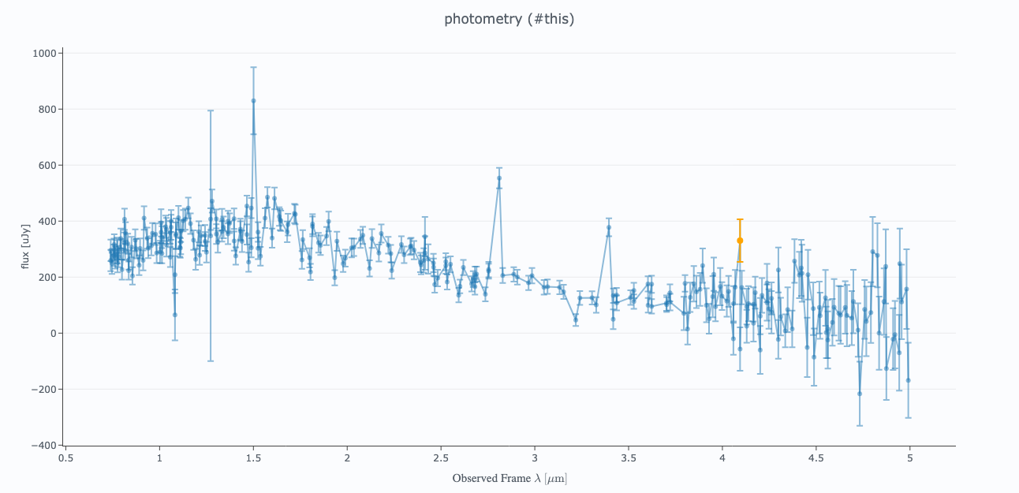
My Research so Far
Observing at longer wavelengths (e.g., Deep IR ~960 nm) shifts flux ratio balance toward the cooler companion
By observing one of the systems in the infrared we can test if we can apply physical parameter constraints to complement the UV and optical constraints of the primary source
System: J0935+4411
x-axis: Flux y-axis: Observed Wavelength (μm)
Image from PanSTARRS-1 Image Access, in the Deep Infrared, ~960 nm
Photometry from Sphere-x
Image: https://ps1images.stsci.edu/cgi-bin/ps1cutouts?pos=12%3A35%3A49.853+++15%3A43%3A18.954&filter=color&filter=g&filter=r&filter=i&filter=z&filter=y&filetypes=stack&auxiliary=data&size=240&output_size=0&verbose=0&autoscale=99.500000&catlist=
Plot: https://irsa.ipac.caltech.edu/applications/spherex/tool-spectrophotometry
Notes:
Explain what i am doing, where i am looking at the light curves of some sources in the inferred to adjust for the no clear modulations. This is where my work comes in: we move to the Infrared. Because the secondary companion is much cooler, its relative flux contribution is significantly higher in the IR. By observing systems like J0935 in the Deep IR around 960 nanometers, we isolate the secondary star to provide the missing physical constraints needed to break optical degeneracies.

Slide 7
Questions?

